Slide 1
¿Cómo poder hacer del tiempo de lectura, un momento único y especial con su niño?
Ana Caballero, M.D., Au.D.
Utah State University, Logan, UT
March 27, 2019
* Con agradecimientos especiales a Kaytie Cook por su previa colaboración.
Notes:
I’d like to give a big welcome for all of those able to join us today. As parents, we need to promote the love for books and reading time. I have a deep love for books and their ability to enrich language, imagination, play and so much more. As we go throughout our presentation, we’ll be discussing how we can use listening and spoken language strategies while reading to create not only meaningful moments, but fun moments!

Slide 2
Objetivos de aprendizaje
¿Que leer?
¿como usar las estrategias de lsl durante el tiempo de lectura?
1
La selección de libros
2
preguntas
3
4
Notes:
We’ll start by reviewing quickly some of the benefits of reading and then dive right into how to implement listening and spoken language strategies into our reading routines. This webinar is designed to give ideas for implementing strategies and will not go into great detail on the definitions of what they are. If you would like a more in depth look at what some of the most commonly used listening and spoken language strategies are, please see our previous webinar done by Claire Annis. After going over ideas for implementing strategies, we’ll briefly talk about selecting books and then have a few minutes left for questions at the end. Let’s get started!

Slide 3
¿Por qué es importante leer a sus hijos?
Desarrollo del lenguaje
Aumenta la imaginación
Desarrolla la teoría de la mente
Aumenta la fluidez para la lectura individual
Asociación con un incremento en el rendimiento académico
Notes:
If your watching this webinar, you most likely already know some of the many benefits of reading. I’ve placed a picture of broccoli here because I feel like reading, like broccoli, is one of those things we know is great but don’t always make time for because, well you know it’s broccoli. My goal is to show you how easy it is to make reading fun and more of a desert than a vegetable. For additional motivation, let’s just look at a few of the things reading does for a child. Reading with your child will increase their exposure to and use of new vocabulary, increase imagination for play, increases a child of theory of mind,
El concepto de Teoría de la Mente, también denominado “comprensión social” se refiere a la habilidad para comprender y predecir la conducta de otras personas, sus conocimientos, sus intenciones y sus creencias. No sólo entendemos que uno mismo es capaz de tener deseos, emociones, intenciones, etc. sino que la teoría de la mente nos permite entender que los otros también tienen sus propios sentimientos, deseos, etc. (Serrat et. al., 2011). Y se empieza a desarrollar a corta edad. La lectura puede fomentar al desarrollo de esta hábilidad.
and when done consistently at home, has been shown to increase fluency for reading, and is associated with higher academic achievements in school for your child.

Slide 4
Uso de las estrategias de LSL cuando se lee en voz alta
Notes:
So lets dive in! Again, we will be focusing on strategy implementation, not definition so if you need a refresher on those, please watch our previous webinar.

Slide 5
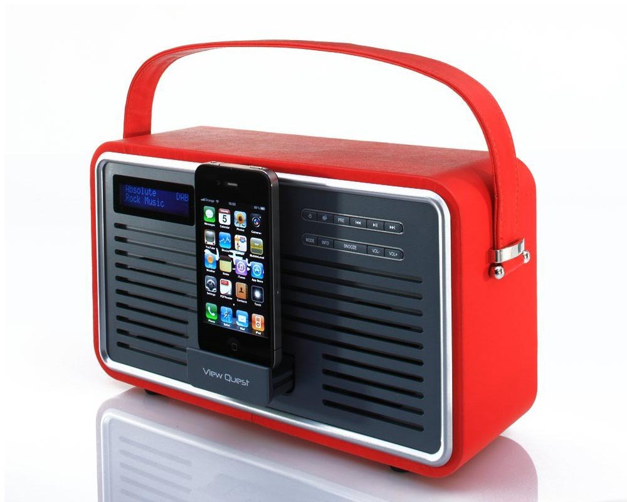
Comentarista de Radio (Narración para sí mismo)
Hable acerca de lo que están haciendo en este momento, no importa que sea algo de rutina o una actividad diaria
Haga de la elección de un libro, un evento importante e interesante, al describir su emoción y su acción mientras los selecciona.
Haga un viaje especial a la biblioteca, vaya “narrando” durante el viaje para crear expectativa en el niño.
Nárrele lo que lee y por que es importante
Notes:
This is an easy strategy to start doing immediately during your reading routine. Consider yourself a radio host with the primary audience being your child. Narrate your excitement about reading, what story elements your excited to discover, or even preview some of the books your child likes to read. An example of what this could sound like is “It’s time to read! I am so excited to open up our books. Let’s walk upstairs and find one we like. Maybe we could read a book about dragons, or monsters. What do you think would be fun? We’re walking up the stairs, we’re getting closer, and closer and closer. Let’s reach into our book shelf and see what we pull out? Yes it’s a monster book! Should we read this one?” You can use this same strategy grocery shopping, driving to the library to select books, and even to help model why reading matters. For an older child, you might model, “We’re going to the grocery store to look for some vanilla ice cream. Let’s look up at the signs and see which one says ice cream. I see it! Let’s walk this way and find our vanilla ice cream. Reading the signs helps us find what we need faster.”

Slide 6
Auditivo Primero
Hablar de la acción o del objeto antes de que usted lo señale o le muestre el objeto. Creando una expectativa.
Mantenga las paginas del libro cercanas a usted, sin que el niño las vea.
Describa lo que ve antes de enseñárselo a su niño, para así aumentar su deseo de escuchar con atención y desarrollar su capacidad de escuchar.
Notes:
I love this strategy to build up excitement for what is to come. It’s also a great way to talk about vocabulary words before you reinforce them with a visual picture. This strategy also helps your child focus on listening without a distracter, which can aid in their auditory skill development. To start, first hold the book close to you or preview the page and then close the book so your child cannot see it. Then…describe! It may sound like this “Oooh, on this next page I see someone very sneaky. This someone has bright red hair and red freckles. They have a green shirt on and bright white shoes! Who do you think it could be? She is sneaking towards the cookie jar. The cookie jar is full of ooey gooey chocolate chip cookies. I wonder if she will get caught trying to sneak an ooey gooey cookie. Should we see?” You can adjust your vocabulary and questions as appropriate for your child’s age. Remember, your voice is your greatest tool in this situation. Don’t be afraid to use those sillies voices or that acoustic highlighting.

Slide 7
Bombardeo Auditivo
Cree repetidas oportunidades para que su niño oiga sonidos de voz, palabras del vocabulario o estructura de la oración. Aún no debes esperar que el niño lo repita de regreso. Por ahora, solamente le está presentando los sonidos muchas veces, de una forma juguetona y divertida.
Escoja una palabra o una frase que le gustaría poder trabajar con su hijo, hasta que el pueda aprender a decirla.
Use esa palabra o frase MUCHAS veces
Notes:
This I feel is a well named strategy. For auditory bombardment, we want to take a specific word or phrase and repeat it as much as possible, or bombard it. As you are thinking about your family and what activities you normally do, think of common phrases or words you want your child to really understand. For example, if you are a family that loves to go camping, select a picture book about camping and bombard away. Let’s say you want to bombard the word “tent” and the purpose of a tent. As you are reading through the camping book, purposely say tent and describe a tent as much as possible. ”They are ready to go camping because they packed their tent. It’s a red tent! They will sleep in their red tent tonight. The tent will keep them safe from the rain or maybe even animals! Tent’s are great. A tent will be like their house when they are outside. Can you show me the tent? You got it! There is the tent!” I hope you have now all thoroughly had the word tent embedded into your brains. What I love about reading books together is that they provide an awesome way to talk about vocabulary and experiences that don’t happen daily, but are important to be exposed to. You can do this with nouns like “tent” but also with descriptive words like “big, small, pointy, shiny” or with feelings like “happy, sad, angry, and upset”. Being able to hear words over and over again in a meaningful context makes them easier to learn. We know that our kids with hearing loss need this extra exposure for the vocabulary words to really cement. Books make that fun!

Slide 8
Sabotaje
Deliberadamente realice situaciones inesperadas o situaciones donde se necesita su ayuda.
Para evaluar el entendimiento o para ayudar a que el niño se enfoque en una actividad de lectura, use un “truco” al leer o comentar incorrectamente (con intención), para que el niño pueda corregirlo.
Esta estrategia no es apropiada para todas las edades, y se debe usar, idealmente con niños mayores de 3 años.
Notes:
Before we jump into this slide I want to make sure I give an appropriate warning. This is a strategy we typically reserve for older children or children with a firm understanding of “tricking”. If you use this strategy without that concept, it may actually confuse your child as opposed to prompting language. As a general rule, I try to avoid this strategy with children under 3, but you know your child and what they understand so adjust for what is best for you. If you have any questions about that, we can address it at the end of the presentation so hold tight as we discus it. Sabotage is a fun way to check for understanding or to provide a chance for your child to correct you. You can do this while reading by purposely describing something wrong or saying something silly and then WAIT. Look at your child and give them the opportunity to process your silly sentence and see if they correct you. If they don’t, you can prompt “Did that sound right?” Or repeat it. For example, if your looking at a picture and the character is about to eat some spaghetti, you could say “I see that he is ready to eat his shoes! Those shoes sure look tasty.” Then pause, wait and look at your child. If you child seems okay with shoe eating, ask “Are those shoes on his plate?” “Do you eat shoes?” Hopefully you are met with a hearty “No!” This playful strategy allows for you to check your child’s understanding of common concepts and be the teacher as they help you understand what should be happening. I love using this with books in Kindergarten.

Slide 9
Cierre Auditivo
Deles la oportunidad de llenar los espacios en blanco con la última palabra o frase en un patrón familiar (esto es especialmente divertido con líneas repetitivas en canciones o libros)
Al trabajar con una frase familiar en un libro, haga una pausa antes de terminar la frase, y dele la oportunidad a su niño que termine o “cierre” la frase con sus propias palabras.
Notes:
I love the picture of a door because I think it’s a great visual reminder of how to use this strategy. Auditory closure is a strategy where you start a common phrase and then pause before finishing it. Then WAIT and let your child finish the phrase or close it, like an open door. We commonly use this with nursery rhymes and simple songs, but it’s also great to make reading fun! If you have a book with a repetitive phrase like the children’s book “No David” by David Shannon, you have a great book for auditory closure. In the book “No David”, a child is always in trouble and keep being told “No David!” on every page. To use this strategy while reading, help your child see the pattern by highlighting the phrase the first few times in the book with your voice. Then after a few times, simply say the first part “NO _______.” And wait for your child to finish it. I always pair this with an expectant look that lets the child know I am waiting for their answer. I call it my “mom” look. As the book goes on, you can expand the part of the phrase they are responsible for. This helps your child recognize patterns in language and conversational turn taking as well.
Cierre Auditivo: Deles la oportunidad de llenar los espacios en blanco con la última palabra o frase en un patrón familiar (esto es especialmente divertido con líneas repetitivas en canciones o libros).

Slide 10
Expansión
Expanda o extienda sobre algo que ha dicho su hijo como una manera de conectar la información adicional o aumentar la longitud de la palabra o frase
Cuando un niño describe o responde en frases cortas, repita lo que ellos dicen y extiéndalo en oraciones completas
Piense como en el proceso de ir agregando aire a un globo para que logre llegar a su tamaño final
Notes:
Another strategy you can use to make reading time meaningful is expansion. Sometimes your child responds in partial phrases or single words. This gives you a perfect opportunity to expand it, or blow it up like this balloon. It could sound like this while reading. You ask your child what they see on the page and they say “Doggy!” You can expand this sentence by saying. “I see a brown doggy with fluffy brown hair. Woof woof! There’s the doggy!” Another example could sound like this. You’re child is holding their book and turning the page. They keep pointing to the same picture over and over again and making a sound “uh uh uh”. You point to it and say “Duck! Duck. It is a duck!”

Slide 11
Énfasis Acústico
Usar su voz para destacar un sonido específico, palabra o frase (extender la palabra, cambiar el tono o el volumen).
Dele mayor enfoque a una palabra o frase al cambiar la entonación de su voz
El cambio del tono o volumen de su voz puede ser mas fuerte, mas suave, o en forma de un susurro
Notes:
We hinted at this strategy earlier in our presentation. It’s strategy that is often used with other strategies to make them more powerful and meaningful. For example, you usually pair acoustic highlighting with expansion, auditory closure and auditory bombardment so your child knows what the target word or phrase is. How does this powerful strategy sound? Think of your voice as a highlighter when you read, changing and emphasizing important words or phrases as you read to make them stand out. You can highlight by making your voice louder, quieter, whispering or simply changing the tone. I’ll model each of these with the words “big dark forest.” We’ll start with being louder. “The kids went searching in the BIG, DARK, FOREST.” Or, (quiet) the kids went searching in the “big dark forest” and the kids went searching in the (whisper) “big dark forest). And last with tone “big, dark forest.” Your voice really is incredible. Don’t be afraid to use it as you model natural tone and speaking.

Slide 12
Tiempo de Espera
Después de darle una indicación/pregunta, conscientemente hacer una pausa (10 segundos) para que su hijo tenga tiempo para procesar la información verbal y construya una respuesta.
Dar una mirada expectante que muestra que está escuchando y ahora es su turno para hablar.
Notes:
This is another strategy we’ve talked a bit about earlier. Wait time. This strategy is again, a partner in the strategy crime world. Children with hearing loss typically need more time to process sound. Knowing this, we consciously allow more time for a child to think before we expect a response. After you ask a question, take a conversational turn or use a strategy to prompt language WAIT. I use my finger and tap my leg ten times before I say something. A typically hearing child needs 3-4 seconds where a child with hearing loss needs ten. Don’t be afraid of the silence, know that you are giving your child time to process and that’s important. So how does this sound? It sounds like silence. And that’s okay!

Slide 13
Dime más/Uso de preguntas para expandir
Use las frases: a ver dime mas, o ¿cuéntame mas de lo que acabamos de leer?, o ¿dime lo que ves en esta página?
Pregúntele al niño partes de la lectura del libro o cuento, usando las palabras:
¿Qué?
¿Quién?
¿Dónde?
¿Por qué?
Notes:
A lot of our earlier strategies have been about helping our child think about and understand language, the receptive part. This strategy is designed to help you give your child opportunities to talk, or express their language. My favorite phrase is “Tell me.” It’s an invitation with a clear direction. For example you are reading your story and you let your child see the picture first with the direction “Tell me what you see!” Paired with wait time, you are giving your child the opportunity to practice saying what they have been hearing. Another way to do this is with simple WH questions. What do you see? How do they look? What is happening? Remember, this is most effective when paired with WAIT time so your child can process the question/ direction and then answer.

Slide 14
Seleccionando un libro
Notes:
With our short time, I hope you’ve enjoyed going over a few ideas of how to use listening and spoken language strategies to make reading time meaningful and fun. With our last few minutes before we open this up to questions, I want to quickly review some tips for selecting books to read aloud.

Slide 15
Busque los libros de temas que le gusten a su hijo (princesas, piratas, monstruos, animales, planetas, etc.)
Utilice los libros por sus imágenes, no por el nivel de su vocabulario
Léalo primero y busque por un lenguaje rico en vocabulario
Trabaje con la maestra de su niño para que le puedan dar sugerencias
Haga de la elección de los libros, un evento muy especial y emocionante
Utilice su biblioteca local
Notes:
(This is my extra material if we need it for questions.)

Slide 16
Para preguntas o solicitar materiales
Notes:
If you have questions, or would like to request materials presented/used during today’s session, please feel free to visit our website, and under the section CONTACT US, we will be glad to respond to any inquires you might have.
Thank you!

Slide 17
Para preguntas o solicitar materiales
Sitio web – “Oír para Aprender”
Contáctanos
Notes:
Si tienen preguntas o les gustaria solicitar materiales presentados ahora, pueden contactarnos a traves del sitio web Oir Para Aprender – CONTACTANOS.
Muchas gracias por su atencion el dia de ahora!

